Slide 1
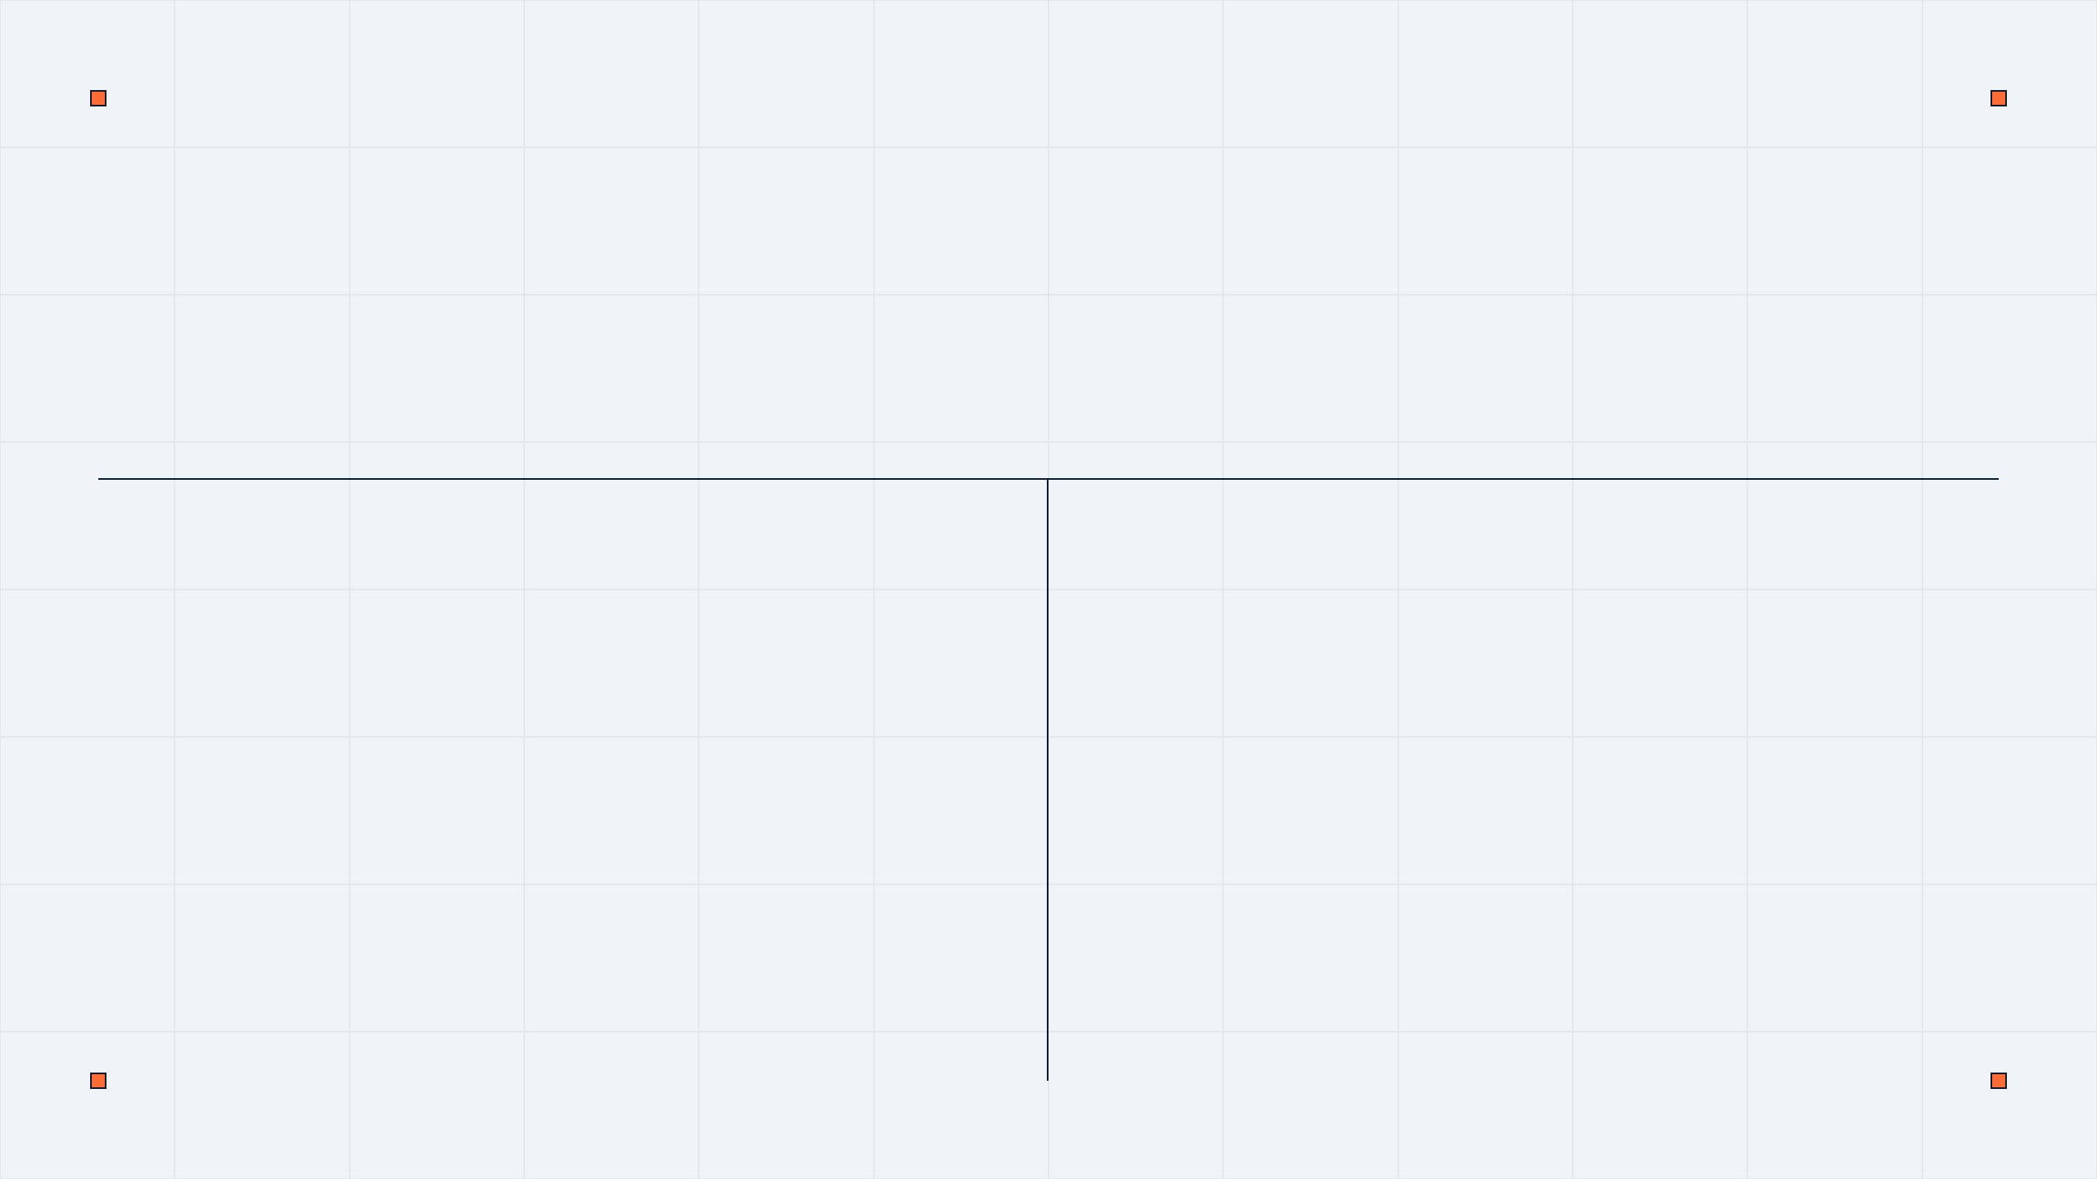

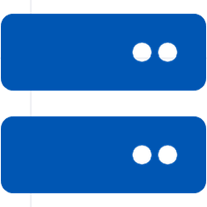
COURSE: CSA05
Database Management Systems
SIMATS Engineering
Understand ER and EER Models
Master Database Architecture
Explore Software Components
Notes:
Welcome everyone to this presentation on Database Management Systems for SIMATS Engineering. We'll explore core concepts of database design, focusing on how databases are built and managed. Our goal is to understand ER models, architecture, and components, all explained in simple English. We're going to keep things clear and practical.

Slide 2


ER DIAGRAMS FOR LIBRARY SYSTEMS
ER stands for Entity-Relationship Diagram
It is a visual map of how data is stored
BOOK
Used to design databases before building them
Entities are objects like Books and Members
BORROW
Relationships show how objects connect
MEMBER
Simple way to plan a Library System
Notes:
An ER Diagram is like a blueprint for a house; it shows the plan before we start building the database. We use it to identify the main objects, called entities, and how they relate to one another. For our library example, we focus on things like books, members, and the borrowing process. This visual map helps us design databases effectively.

Slide 3
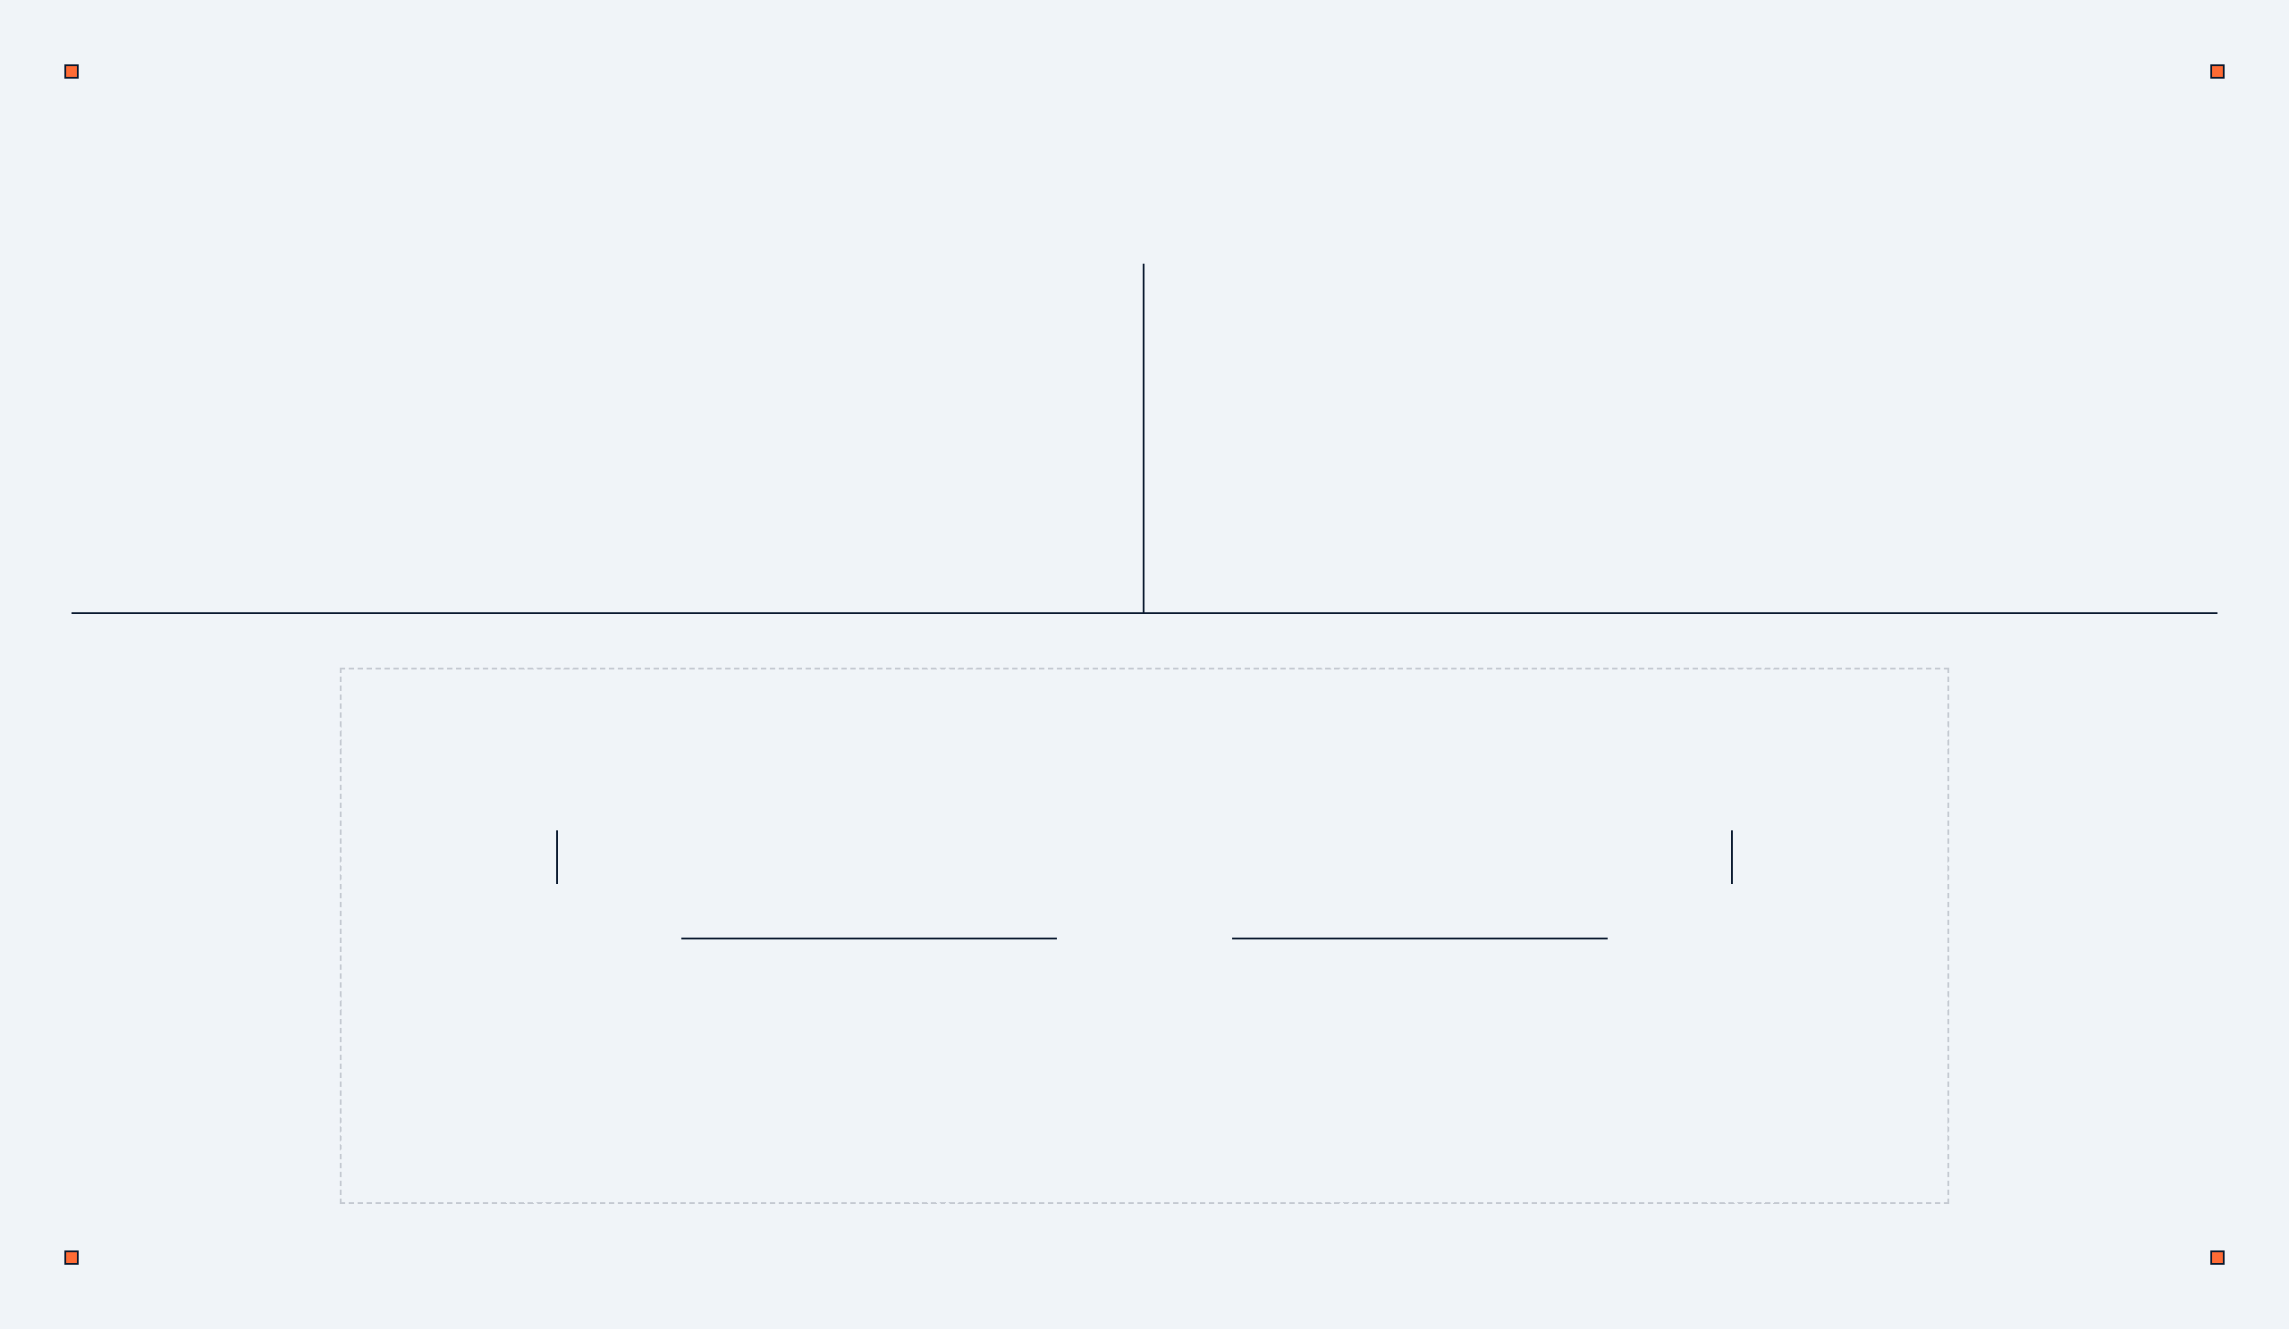
BUILDING THE LIBRARY ER DIAGRAM
Entities: Book (ID, Title), Member (ID, Name)
Diamonds: Used for actions (Relationships)
Relationship: Member "Borrows" Book
Ovals: Used for details (Attributes)
Rectangles: Used for main objects (Entities)
Primary Key: Underlined unique ID for each entity
Book_ID
Member_ID
BOOK
MEMBER
BORROWS
Notes:
Now, let's see how we actually build that blueprint. In our diagram, we use rectangles for entities like 'Book' and 'Member'. The diamond shape represents the action, such as a member 'borrows' a book. Remember to underline the Primary Key, which is the unique number that identifies each item or person. This helps us create clear and organized database structures.

Slide 4


UNDERSTANDING THE EER MODEL
EER stands for Enhanced Entity-Relationship
It adds more features to the basic ER model
Basic ER
Used for complex data that needs better grouping
+
Main concepts: Generalization and Specialization
Enhanced Features
(EER)
University Example: Grouping students and staff
Goal: Make database design more organized
Notes:
Sometimes a simple ER diagram isn't enough for complex systems, like a university. The Enhanced ER model, or EER, gives us more tools to group similar objects together. It helps us handle different types of users, like students and employees, more efficiently. This model makes database design more detailed and organized.

Slide 5
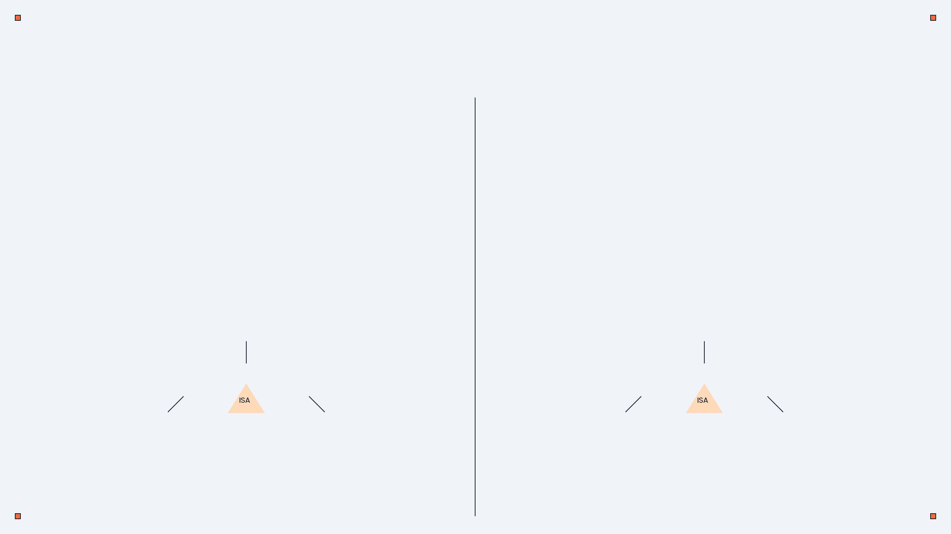
GENERALIZATION AND SPECIALIZATION
Generalization (Bottom-Up)
Specialization (Top-Down)
Combining small groups into one big group
Breaking a big group into smaller ones
Example: UG and PG Students become "Student"
Example: "Employee" becomes Professor or Staff
Reduces repeated data in the database
Used when sub-groups have unique details
Helps in grouping similar objects together
Saves storage space by being specific
STUDENT
EMPLOYEE
ISA
ISA
UG STUDENT
PG STUDENT
PROFESSOR
OFFICE STAFF
Notes:
Generalization is like saying both UG and PG students are simply 'Students,' combining smaller groups into one big one. Specialization is the opposite, where we divide employees into specific roles like 'Professor' or 'Office Staff.' This helps reduce repeated data and saves storage space by being more specific. Next, we'll look at how these concepts contribute to data independence.

Slide 6


WHAT IS DATA INDEPENDENCE?
Ability to change data at one level without affecting others
Makes the database easy to update and maintain
External Level (User View)
Prevents rewriting programs when hardware changes
Conceptual Level (Logic)
Keeps the user experience consistent and smooth
Essential for professional engineering systems
Internal Level (Physical)
Notes:
So, we've talked about how to group data with generalization and specialization. Now, let's talk about something called Data Independence. This is super important because it lets us change how data is stored without breaking the whole system. It means if you change the hard drive or the table structure, the user doesn't even notice. This saves engineers a lot of time because they don't have to rewrite code every time a small change happens. We'll dive deeper into the two types of independence next.

Slide 7
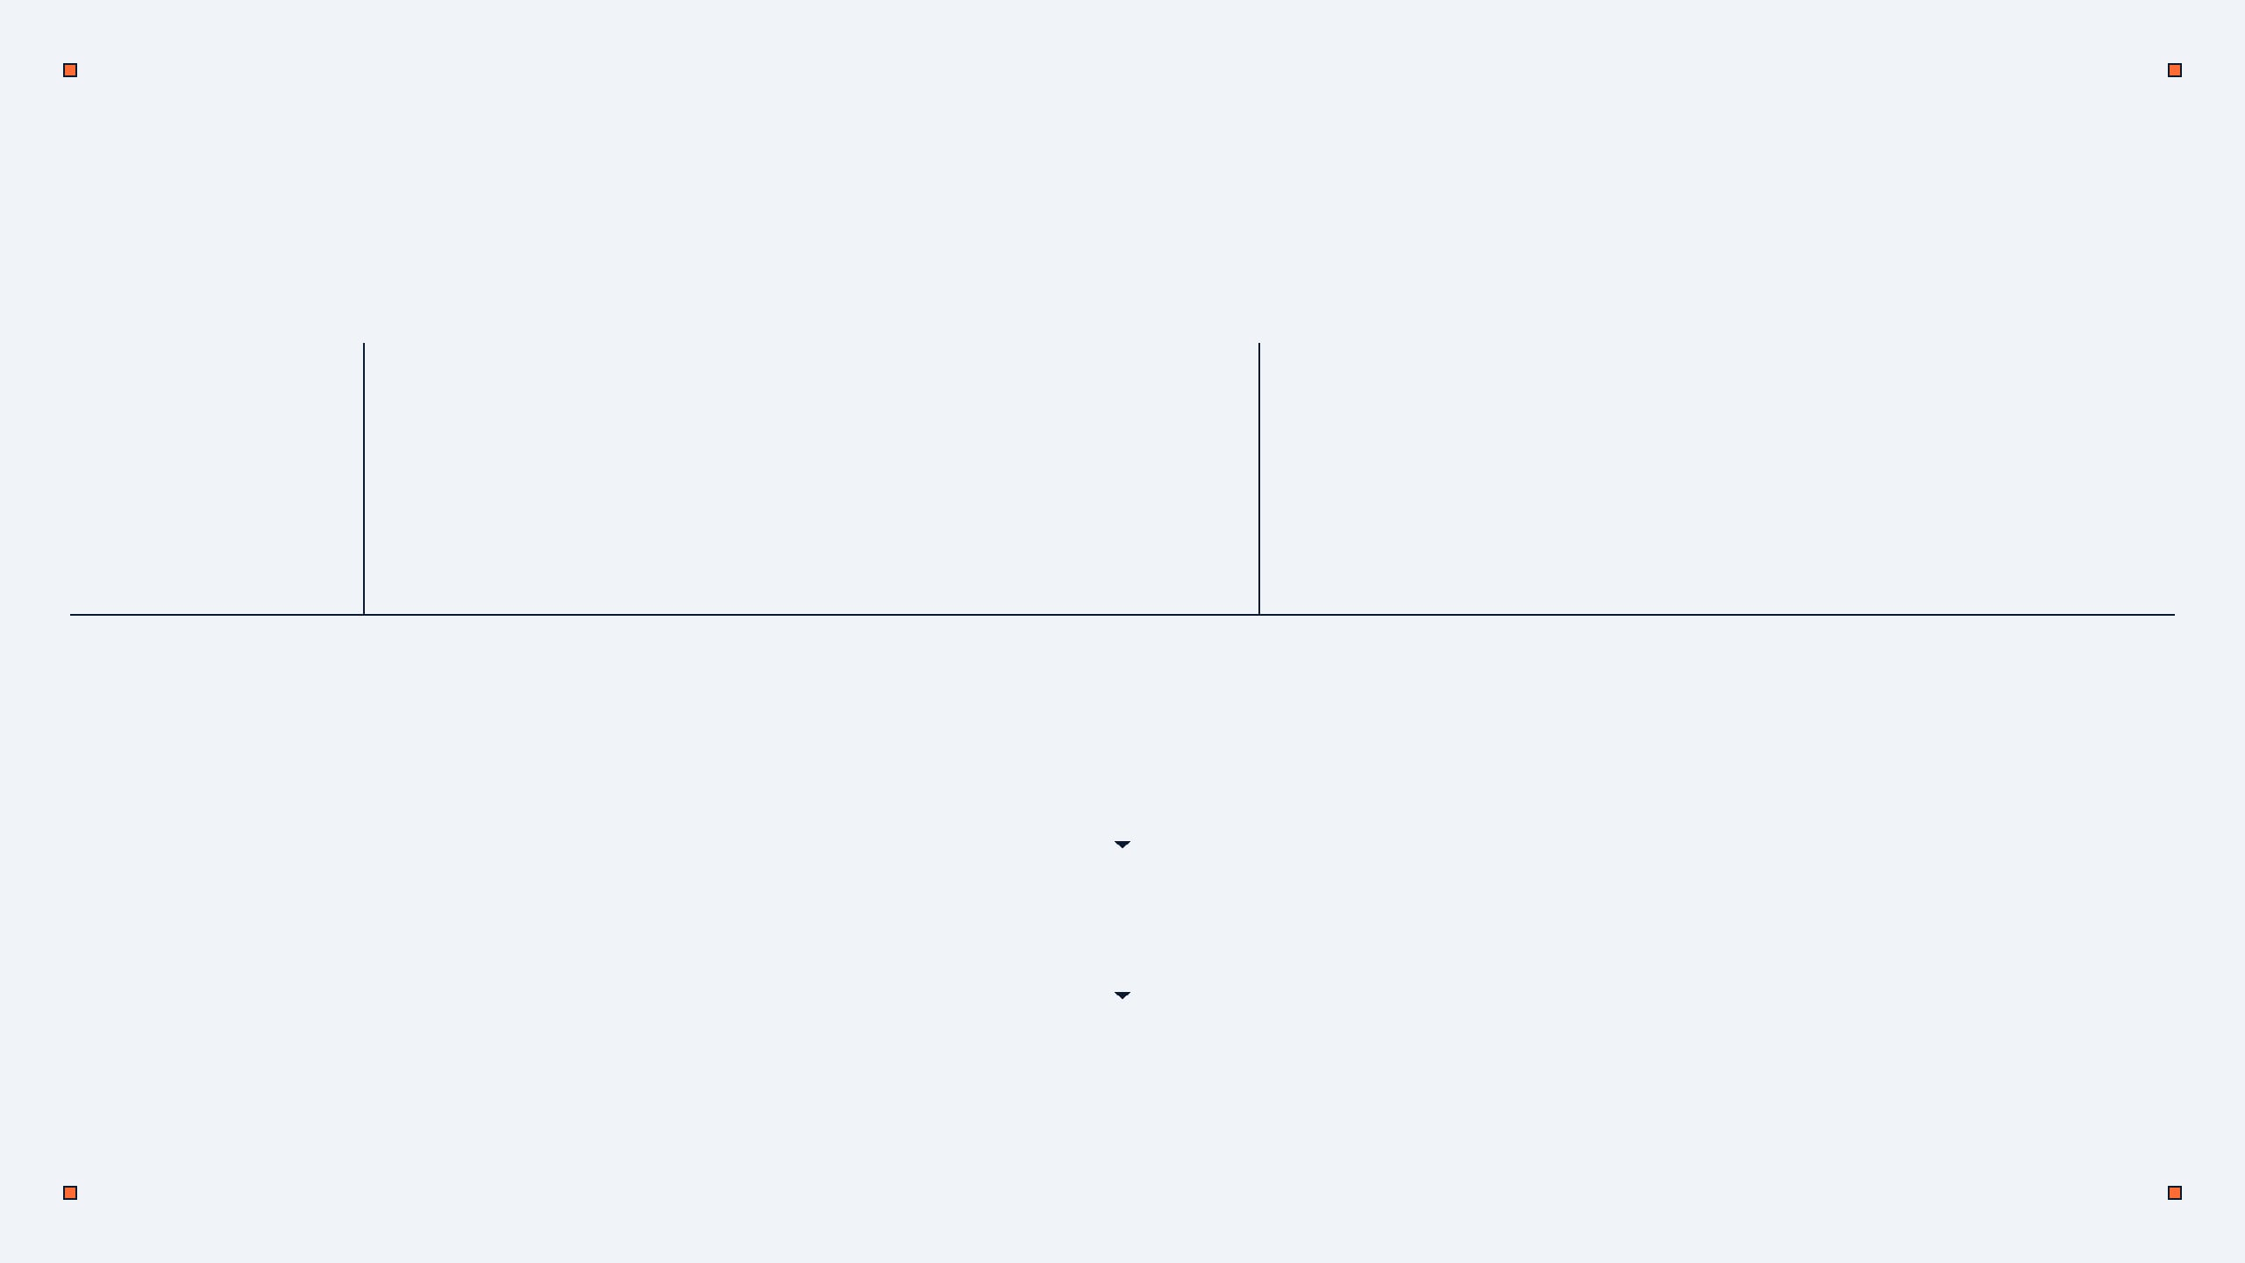
PHYSICAL VS LOGICAL INDEPENDENCE
FEATURE
PHYSICAL INDEPENDENCE
LOGICAL INDEPENDENCE
Focus
Hardware and Storage (Disks)
Table Structure and Logic
Level
Internal Level
Conceptual Level
Benefit
Change disks without breaking logic
Change tables without breaking view
EXTERNAL LEVEL (User View)
LOGICAL INDEPENDENCE
CONCEPTUAL LEVEL (Table Logic)
PHYSICAL INDEPENDENCE
INTERNAL LEVEL (Physical Storage)
Notes:
Building on that, Data Independence comes in two main flavors: Physical and Logical. Physical independence is about the 'Internal Level'—like moving data from a slow disk to a fast one without affecting the programs. Logical independence is about the 'Conceptual Level'—like adding a new column to a table without confusing the user's view. Both are essential for a professional database that needs to grow and change over time. Now, let's look at the different parts that make up a DBMS.

Slide 8




DBMS SOFTWARE COMPONENTS
A DBMS is made of several working parts that manage your data.
Query Processor
Storage Manager
Transaction Manager
Handles user requests
Controls data on the disk
Keeps data safe during changes
Translates SQL code
Manages files and memory
Handles multiple users at once
Finds the fastest way to get data
Ensures data is easy to reach
Prevents data loss or errors
Notes:
We just saw how data independence keeps things flexible. Now, let's talk about the different parts that make up a DBMS. Think of a DBMS as a team of experts working together to manage your data. The Query Processor is the translator, the Storage Manager is the warehouse keeper, and the Transaction Manager is the security guard. Together, they make sure your data is fast to find and never gets lost. We'll explore the Query Processor and Storage Manager in more detail next.

Slide 9


QUERY AND STORAGE MANAGEMENT
Query Processor Flow
USER / SQL QUERY
User sends an SQL Query
Processor parses and checks the code
Optimizer finds the best way to run it
QUERY PROCESSOR
Executor gets the data from the database
Final output is shown to the user
STORAGE MANAGER
Storage Manager Role
Manages files and memory space
Links physical disk to software
PHYSICAL DATABASE
Notes:
So, we've met the team. Now, let's see how the Query Processor and Storage Manager work together. When you type a search, the Query Processor finds the fastest way to get the answer. Meanwhile, the Storage Manager is busy organizing the files on the hard drive so they are easy to reach. This teamwork is why modern databases can handle millions of requests per second. Next, we'll shift gears to talk about strong and weak entities.

Slide 10
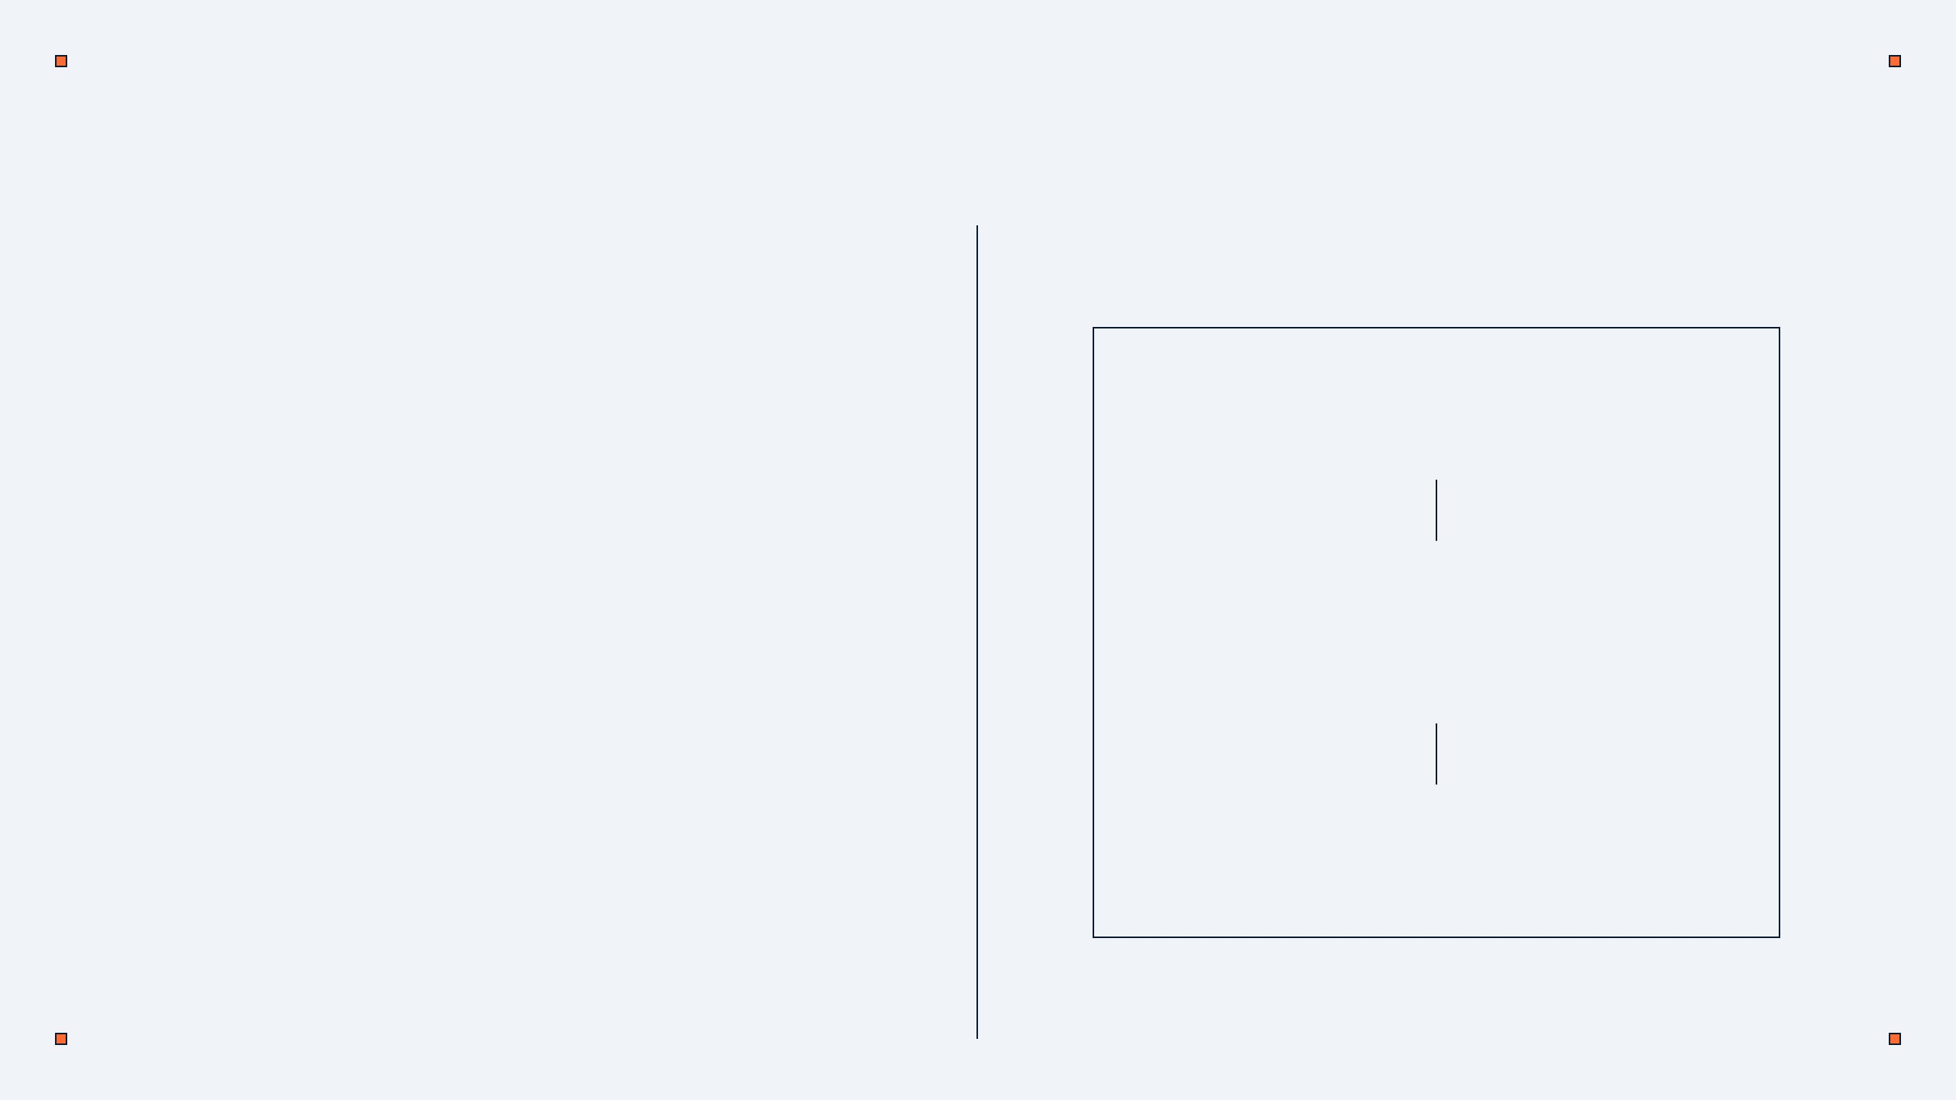
STRONG VS WEAK ENTITIES
Strong Entity: Can exist on its own (e.g., Student)
STUDENT
(Strong)
Has its own unique Primary Key
Weak Entity: Depends on another entity (e.g., Dependent)
Does not have its own Primary Key
HAS
Uses a "Double Rectangle" in diagrams
Needs a "Double Diamond" relationship
DEPENDENT
(Weak)
Notes:
Now, let's shift our focus to how we categorize entities within our database designs. We have two main types: strong and weak entities. A strong entity is like a 'Student' in a university; it can exist completely on its own and has its own unique ID. But a weak entity, like a 'Dependent' or an 'Emergency Contact', needs that student to exist. It doesn't have its own primary key. In our diagrams, we use a double border for weak entities to show this dependency. This helps us understand how different pieces of information rely on each other. Let's look at a comparison to make this clearer.

Slide 11
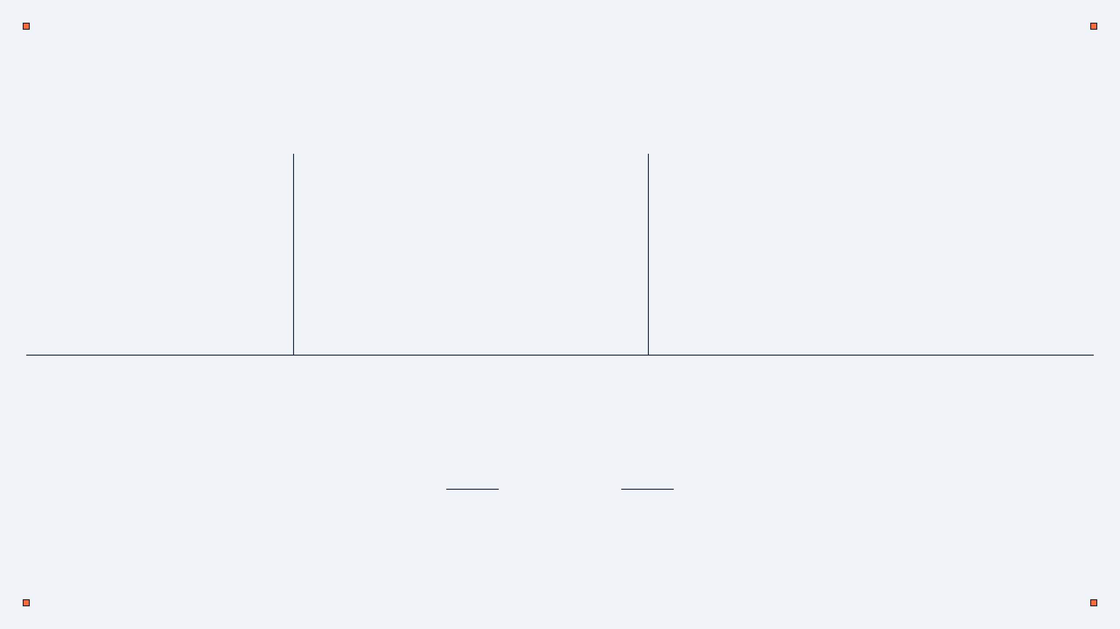
COMPARING ENTITY TYPES
FEATURE
STRONG ENTITY
WEAK ENTITY
Has its own full key
Uses a partial key
Primary Key
Independent
Depends on Strong Entity
Dependency
Single Rectangle
Double Rectangle
Symbol
University
Department
Example
REAL-WORLD EXAMPLE
UNIVERSITY
DEPARTMENT
HAS
*The Department cannot exist without the University.
Notes:
Building on our last slide, the key difference between strong and weak entities really comes down to their primary key. A strong entity has its own full primary key, making it independent. But a weak entity uses a partial key, and it always depends on a strong entity. Think of a 'University' as a strong entity; it stands alone. A 'Department' within that university is a weak entity because it can't exist without the university. Understanding this helps us create correct relationships in our database tables, preventing data from being orphaned. Now, let's bring everything together with a quick summary.

Slide 12








CONCLUSION AND SUMMARY
ER & EER Models for Planning
Data Independence & Architecture
THANK YOU
Core DBMS Software Components
Any Questions?
Strong vs Weak Entity Design
Building Efficient Databases
SIMATS Engineering Course: CSA05
Notes:
To wrap up, we've covered a lot today, from ER and EER models for planning to understanding data independence and the core components of a DBMS. We also just explored how strong and weak entities help us design robust databases. Remember, good design is the backbone of efficient, fast, and secure databases. It's all about building systems that work well and last. Thank you for your time, and I'm happy to answer any questions you might have.

